Slide 1
Youth Against Fake Web
Internet Scams and digital rights Quiz

Slide 2
Scams and internet rights quiz - Question 1
Scam?
Real?

Slide 3
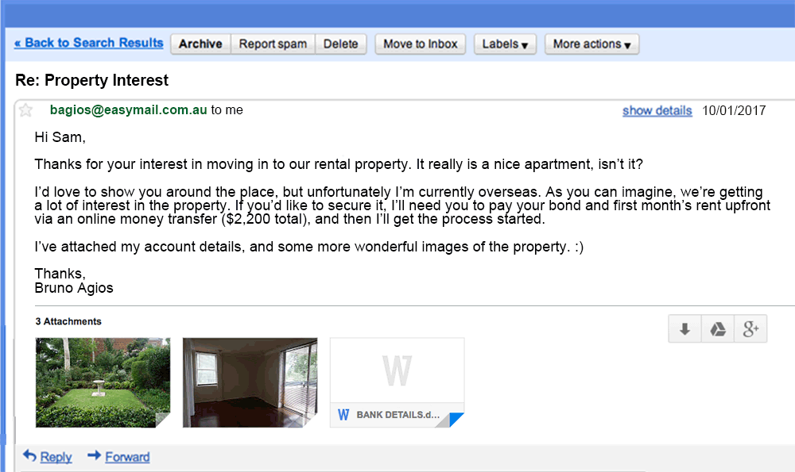
Question 2
Scam?
Real?
Asking for ‘prepayment’ is often a sign of a scam

Slide 4
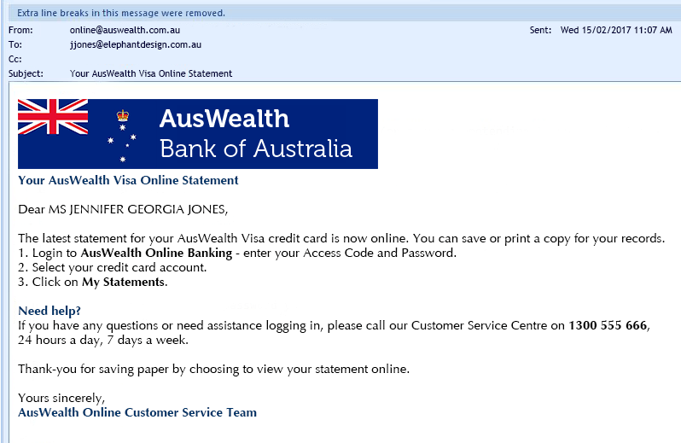
Question 3
Scam?
Real?

Slide 5
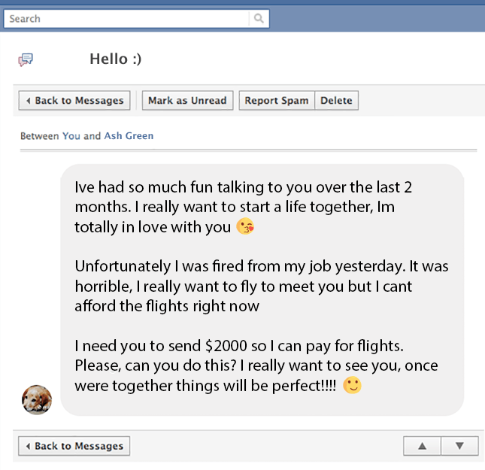
Question 4
Scam?
Real?

Slide 6
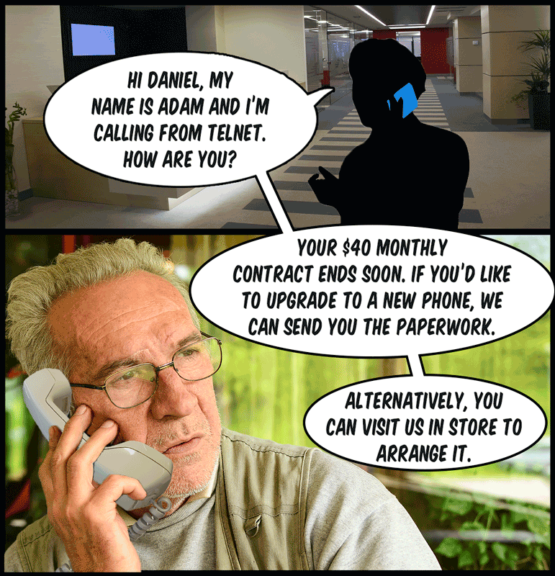
Question 5
Scam?
Real?

Slide 7
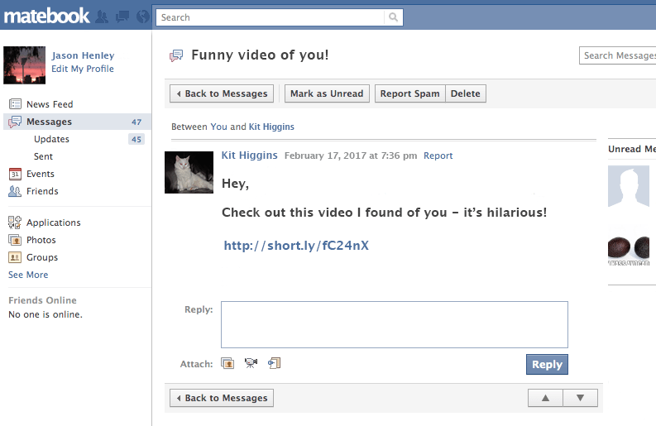
Question 6
Scam?
Real?

Slide 8
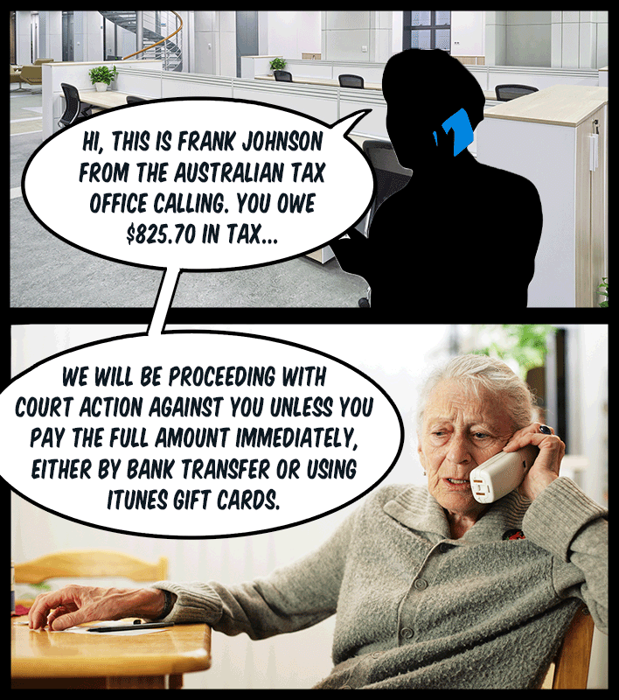
Question 7
Scam?
Real?

Slide 9
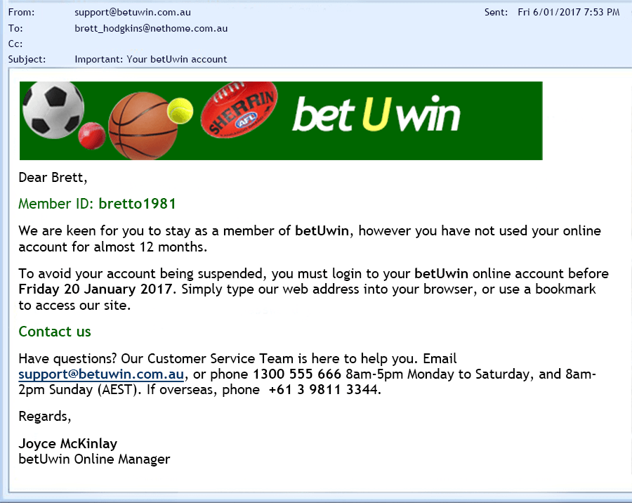
Question 8
Scam?
Real?

Slide 10
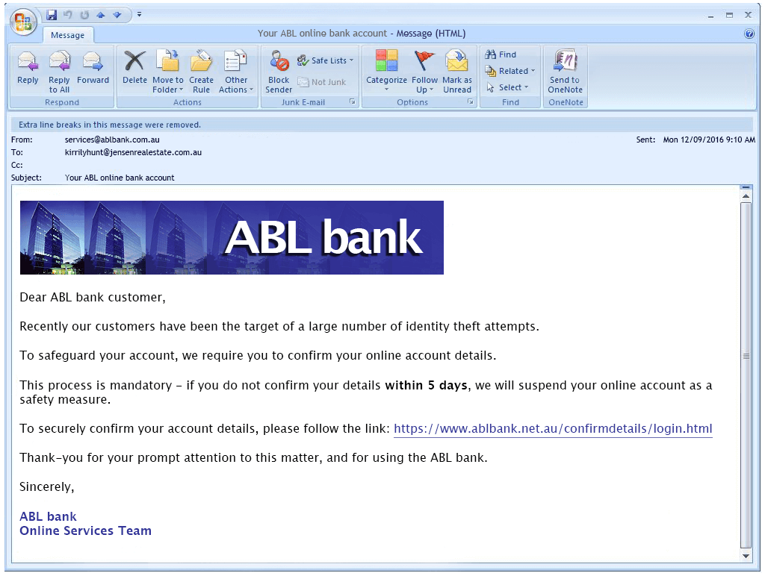
Question 9
Scam?
Real?

Slide 11
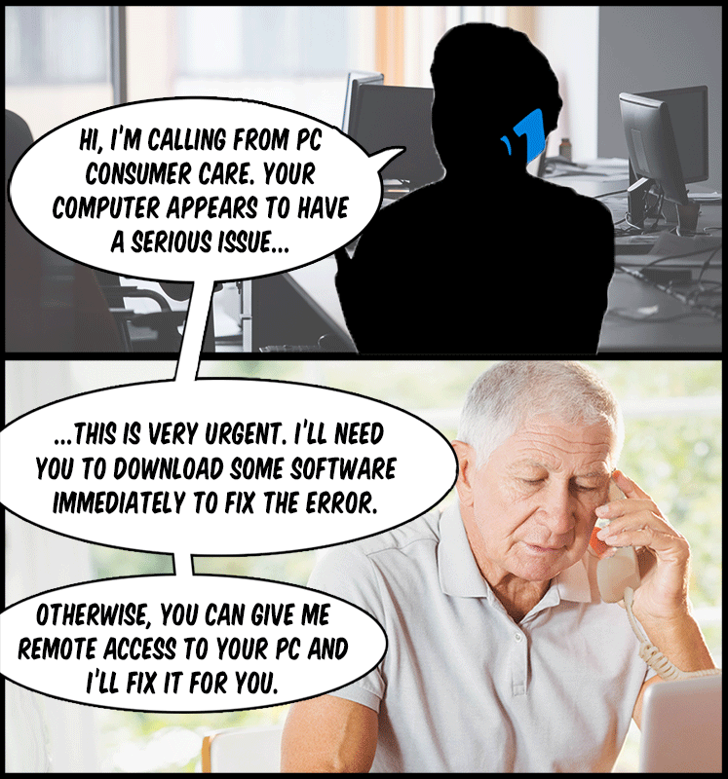
Question 10
Scam?
Real?

Slide 12
Question 11
John is a student studying music at a local university. Upon being caught downloading music illegally, John argues that he had the right to take the music as he needed it to improve his knowledge base. Is John justified in arguing this?
Yes, John has the right to share knowledge on the internet
Yes, because after all John wasn't the one who uploaded the files
No, John should have realized that the creator of the music has not made their product available for free, public consumption and that he was stealing.

Slide 13
Question 12
Which of the following rights are included in the APC Internet Rights Charter?
The right to freedom of expression
The right to freedom from censorship
The right to engage in online protest
All of the above.
A and B

Slide 14
Question 13
True or False: Affordable, fast and easy access to the internet can help create more egalitarian societies.
True
False

Slide 15
Question 14
The right to data protection ensures that...
Organizations will only use collected information for the stated purpose of why it was collected.
Organizations will delete information after it is no longer needed.
Organizations are permitted to sell information as long as it is to a certified safe organization.
All of the above.
A and B

Slide 16
Question 15
A government organization has created a new website that they believe will improve user experience. Shortly after its launch they begin receiving a huge number of complaints stating that the website cannot be viewed properly on many computers due to the high-performing graphics card required to see the information. Which, if any, rights have been violated by this government organization?
No rights have been violated.
The right to engage in online protest.
The right to freedom of information.
The right to open technological standards.

